Slide 1


CUSTOMER CHURN PREDICTION
A unified platform for customer churn prediction — combining real-time machine learning, time series forecasting, and an intuitive analytics dashboard to help you act before customers leave.
CUSTOMER CHURN PREDICTION
ML-POWERED

Slide 2
What We're Building
Project Overview
An end-to-end machine learning platform purpose-built to identify at-risk customers, surface actionable insights, and enable data-driven retention strategies at scale.
Predict Churn Early
Identify at-risk customers weeks before they leave using advanced ML models trained on behavioural signals.
Real-Time Scoring
Low-latency REST API delivers live churn probability scores that integrate seamlessly into existing workflows.
Actionable Dashboards
Interactive visualisations surface churn trends, feature importance, and retention opportunities for every stakeholder.
Model Lifecycle Management
Version, monitor, and retrain models continuously to ensure predictions stay accurate as customer behaviour evolves.

Slide 3
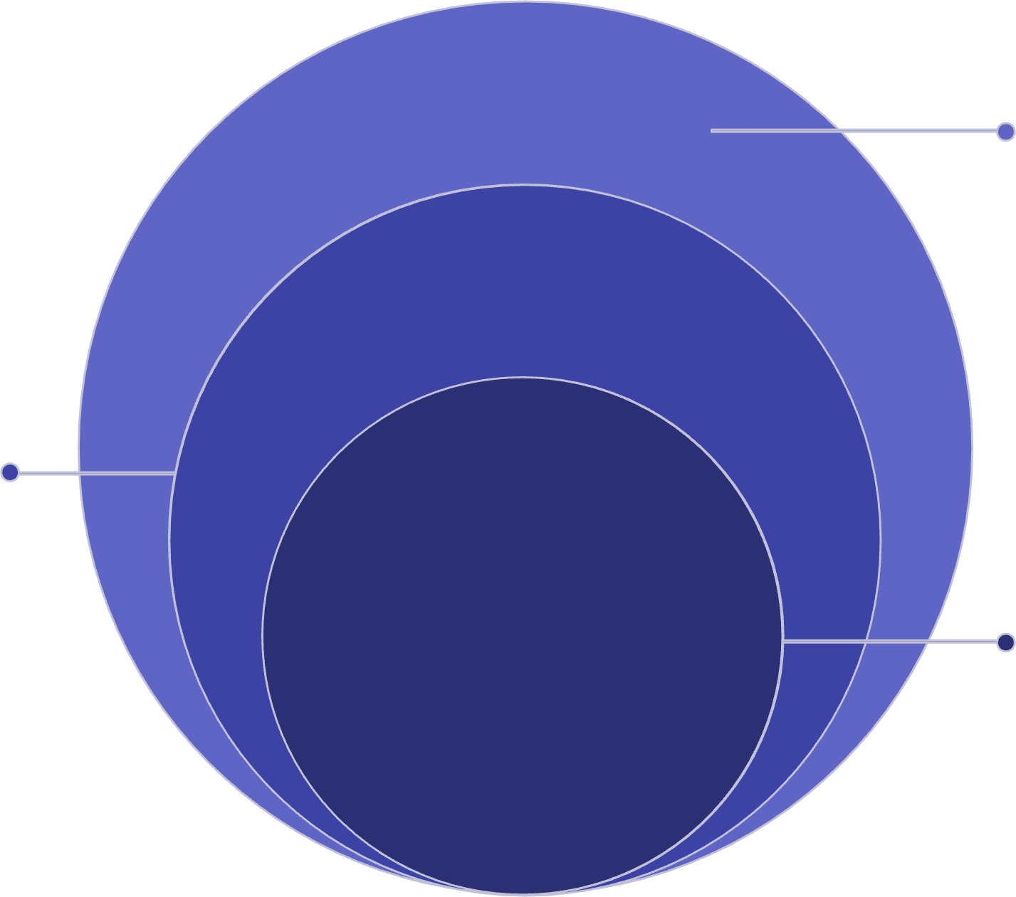
System Architecture
How It All Fits Together
Frontend Dashboard
React UI with charts, alerts, stakeholder views
API Layer
FastAPI endpoints, auth, rate limiting, integrations
ML Pipeline
Data ingestion, feature engineering, model inference, retraining
The platform follows a clean three-tier architecture — a responsive frontend for stakeholders, a high-performance API layer for integrations, and a robust ML pipeline for continuous model training and inference. Each layer scales independently.

Slide 4

Technology Stack
Data & ML
Visualisation
Python · scikit-learn · XGBoost · Prophet · Pandas · NumPy
Plotly · Dash · Matplotlib ·
Seaborn
Frontend
Backend
React · TypeScript · Tailwind CSS · Recharts
FastAPI · Celery · Redis ·
PostgreSQL · MLflow

Slide 5
Codebase at a Glance
Project Structure
frontend/
/churn-platform
├── /frontend
├── /api
├── /ml_pipeline
# React dashboard # FastAPI service
# Training & inference
React-based dashboard with real-time churn scores, segment filters, and retention alerts.
│ | ├── | /data | # | Ingestion & processing
│ | ├── | /features | # | Feature engineering
│ | ├── | /models | # | Model artefacts
│ | └── | /scheduler | # | Retraining jobs
├── | /monitoring |  | # | Drift & performance
├── | /tests |  | # | Unit & integration
ml_pipeline/
Modular pipeline covering ingestion, feature engineering, model training, and scheduled retraining.
└── docker-compose.yml
monitoring/
Tracks model drift, data quality, and prediction performance over time.

Slide 6



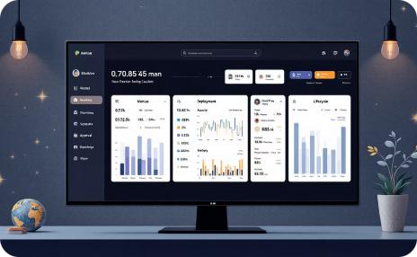
Core Capabilities
Key Features
Time Series Forecasting
Prophet-powered forecasting predicts churn probability over a rolling 90- day horizon, enabling proactive retention campaigns.
Real-Time API
Sub-100ms REST API
endpoints deliver live churn scores, customer risk tiers, and feature explanations on demand.
Analytics Dashboard
Segment-level dashboards surface churn drivers, cohort trends, and customer health scores in a single view.
Model Management
MLflow-backed model registry with automated retraining, A/B testing, and drift alerts to keep accuracy sharp.

Slide 7

Why It Matters
Model Explainability & Trust
Stakeholder trust is critical for adoption. The platform integrates SHAP (SHapley Additive exPlanations) to make every churn prediction transparent and auditable.
Feature Importance
Understand which signals — usage drop, support tickets, billing events — drive each customer's churn risk.
Individual Explanations
Per-customer SHAP waterfall charts give your retention team the context needed to personalise outreach.
Regulatory Readiness
Explainability outputs support compliance requirements and internal audit trails for model-driven decisions.

Slide 8
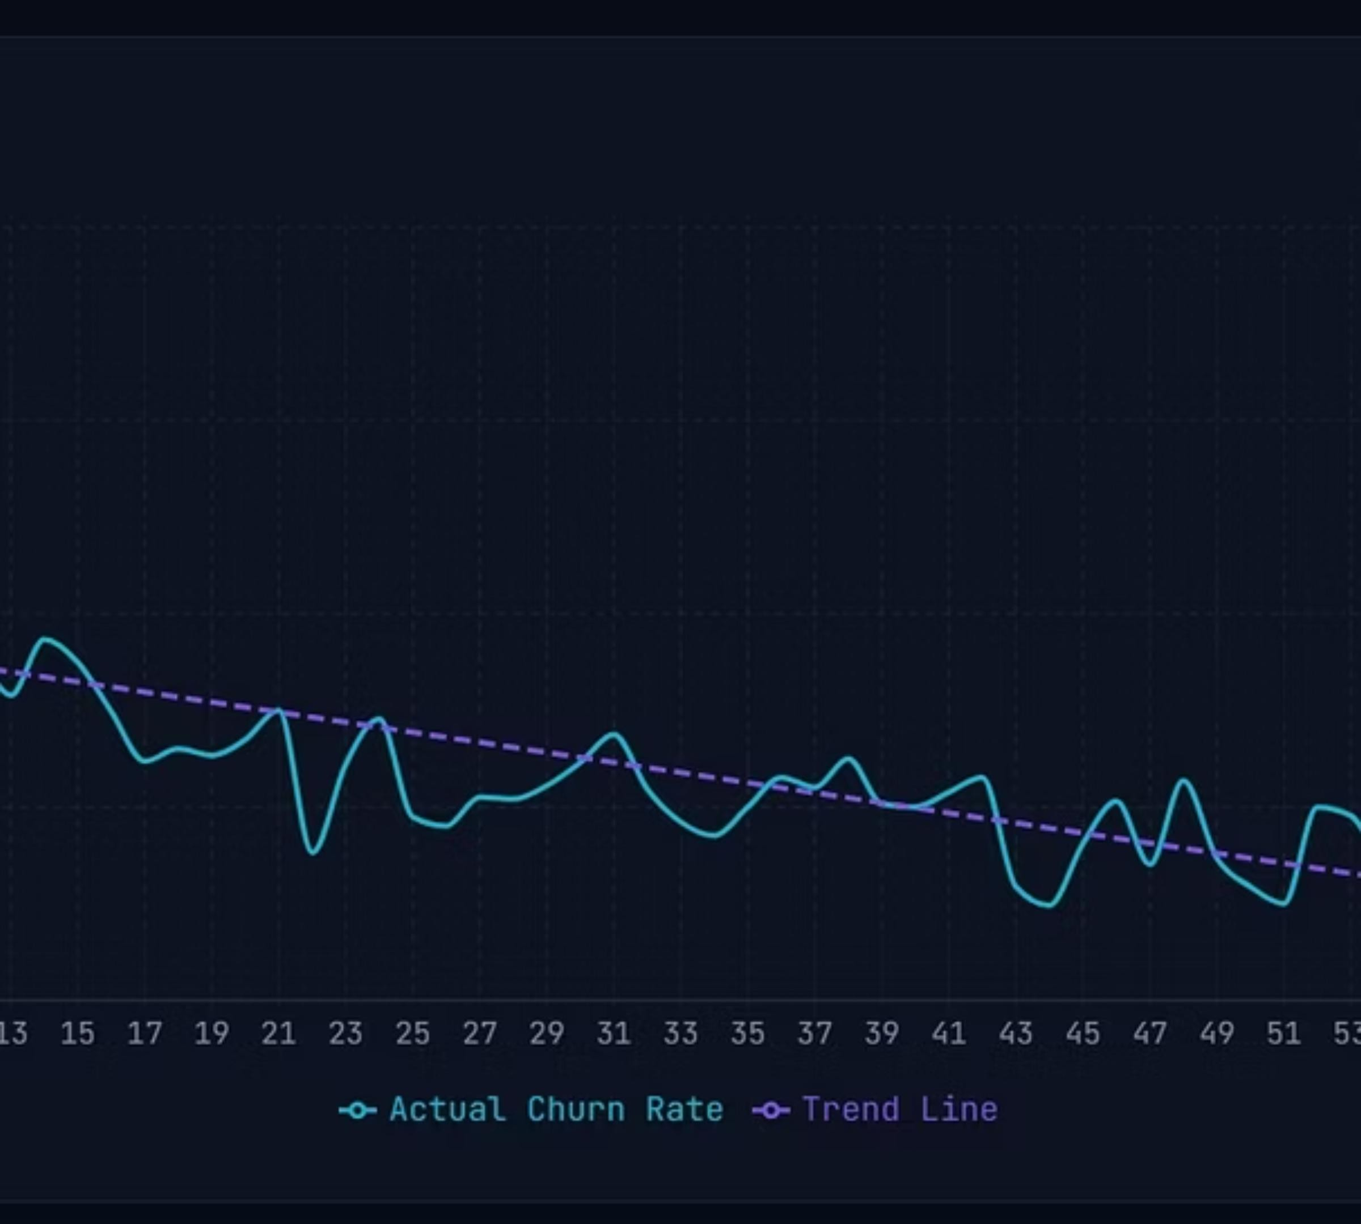
Churn Rate Time Series
This chart shows the actual churn rate trend over time with a trend line overlay, demonstrating how churn patterns evolve and can be forecasted.

Slide 9

Getting Started
Up and Running in Minutes
01
Prerequisites
Clone & Configure
Clone the repository and copy
Docker Desktop 4.x or higher
Python 3.10+ (for local dev)
Node.js 18+ (for frontend dev)
8 GB RAM minimum recommended
.env.example
to .env. Set your database
credentials, Redis URL, and API keys.
02
Launch with Docker
Full documentation and a sample dataset are included in your team onboard quickly.
/docs
to help
Run
docker-compose up --build
to spin up all services — API, ML
pipeline, Redis, PostgreSQL, and the React dashboard.
03
Ingest Your Data
Upload historical customer data via the dashboard or POST to
/api/v1/ingest. The pipeline auto-triggers feature engineering.
04
Train & Go Live
Kick off model training from the dashboard. Once complete, the API is live and serving real-time churn scores.

Slide 10




Ready to Deploy.
The Data Science & ML Platform is production-ready — containerised, monitored, and built to scale with your customer base. Start predicting churn before it costs you.
Deploy Today
Immediate Insights
First churn scores within hours of data ingestion
One
docker-compose
command
to production
Always Improving
Automated retraining keeps models sharp over time

